Slide 1
Integrating the Healthcare Enterprise
IHE Overview 2010

Slide 2
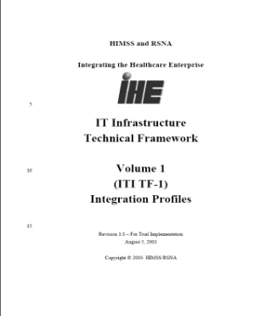
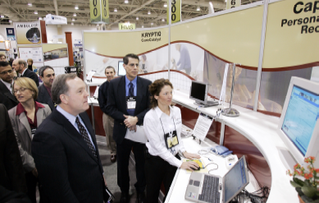
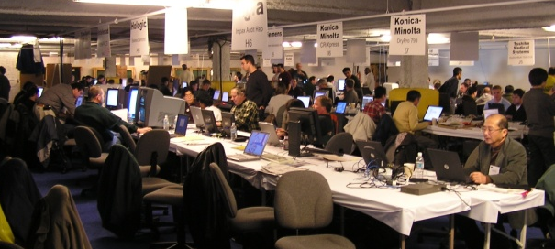
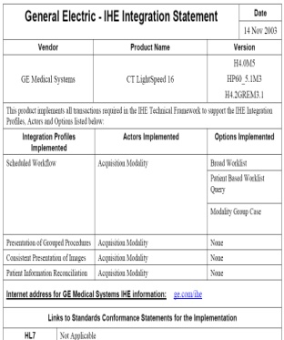



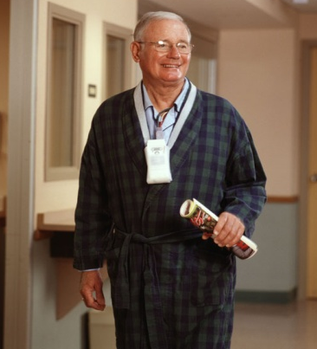
IHE Standards Adoption Process
Adopted by International Standards Organization: TR 28380
Testing at Connectathons
IHE Demonstrations
Develop technical specifications
Products with IHE
Identify available standards (e.g. HL7, DICOM, IETF, OASIS)
Timely access to information
Document Use Case Requirements
Easy to integrate products

Slide 3















The IHE Development Domains
12 Years of Steady Evolution 1998 – 2010
Radiology
since 1998
Pharmacy
NEW 2009
Pathology
since 2006
Cardiology
since 2004
Eye Care
since 2006
Laboratory
since 2004
(Healthcare)
IT Infrastructure
since 2003
Quality
Research & Public Health
since 2006
Radiation Oncology
since 2004
Patient Care Devices
since 2005
Patient Care Coordination
since 2004

Slide 4

International Growth of IHE
Malaysia
Australia
  Local Deployment
  National Extensions
  Promotional & Live Demonstration Events
  Funding
Austria
China
Spain
Netherlands
Norway
Taiwan
Korea
Canada
UK
Japan
Italy
Germany
France
USA
1999
2000
2001
2002
2003
2004
2005
2006
2007
2008
2009
Pragmatic global standards harmonization + best practices sharing

Slide 5
IHE Domains Milestones – 20 month cycle
Development and Deployment
Proposed Scope
- 10 ---
Approved Scope
- 7 ---
Sponsors announce Connect-a-thon/Demos with set of Implementation Profiles
Public Comment
- 2 ---
Trial Implementation
0 ---
Connect-a-thon/Demo Vendor Participant Registered
+ 2 ---
+ 5 ---
Vendor Participant passed Connectathon
+ 6 ---
Demo & Education Material
Final Integration Profile
+ 9 ---
Vendors release products with IHE Integration Statements
+ 10 ---

Slide 6
Schedule
Development Schedule
Call for Proposals: August
Reviews: September
Planning Committee: October
Technical Committee: November
Planning Committee Decision: December
IHE Connectathon: January
HIMSS Demonstration: February
Technical Committee Face to Face: March
Development: April-May
Technical Committee Face to Face: June
Public Comments: July
Technical Committee Face to Face: August
Issue Trial Implementation version: August

Slide 7
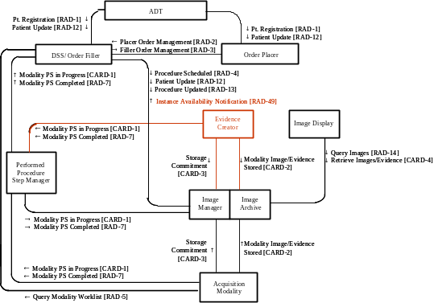

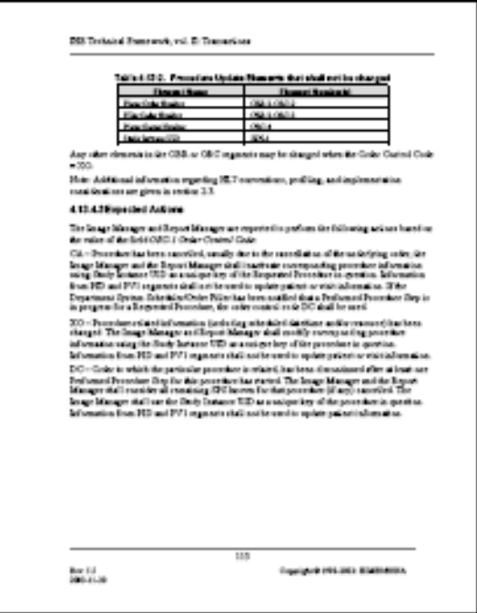
IHE Profiles
Actor/Transaction Diagrams
Department System
Department System
Image
Order
Image
Order
Acquisition
ADT
Acquisition
ADT
Scheduler/
Scheduler/
Manager/
Placer
Manager/
Placer
Modality
Order Filler
Modality
Order Filler
PPS Manager
Register
PPS Manager
Register
J.Doe
Patient
J.Doe
Patient
Registration [RAD
Registration [RAD
-
-
1]
1]
Placer Order
Placer Order
Sequence Diagrams
Management
Management
–
One or the
–
One or the
New [RAD
New [RAD
-
-
2]
other methods
2]
other methods
of creating an
of creating an
Filler Order
order is used
Filler Order
order is used
Management
Management
-
-
Schedule
New [RAD
Schedule
New [RAD
-
-
3]
3]
Procedure
Procedure
Procedure
Procedure
Scheduled [RAD
Scheduled [RAD
-
-
4]
4]
Query Modality Worklist [RAD
Query Modality Worklist [RAD
-
-
5]
5]
Perform
Modality Procedure
Perform
Modality Procedure
Modality Procedure
Filler Order
Modality Procedure
Filler Order
Acquisition
Step In Progress
Acquisition
Step In Progress
Step In Progress
Mgmt
Step In Progress
Mgmt
-
-
Status
Status
[CARD
[CARD
-
-
1]
1]
[CARD
[CARD
-
-
1]
Update [RAD
1]
Update [RAD
-
-
3]
3]
Modality Procedure
Modality Procedure
Modality Procedure
Patient Reconciliation
Modality Procedure
Patient Reconciliation
Filler Order
Filler Order
Step Completed
Step Completed
Step Completed
Mgmt
Step Completed
Mgmt
-
-
Status
Status
[RAD
[RAD
-
-
7]
[RAD
7]
[RAD
-
-
7]
J.Doe
7]
J.Doe
-
-
>
>
Update [RAD
Update [RAD
-
-
3]
J.Smith
3]
J.Smith
Patient Update/
Patient Update/
Patient Update/
Merge [RAD
Patient Update/
Merge [RAD
-
-
12]
12]
Merge [RAD
Merge [RAD
-
-
12]
12]
Detailed standards implementation guides
Textual Description

Slide 8
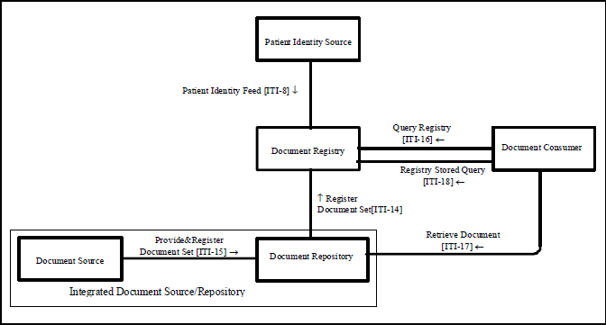
IHE Profiles

Slide 9
IHE Connectathon
Open invitation to any vendor and other implementors
Advanced IHE testing tools (MESA, KUDU, GAZELLE)
Testing organized and supervised by independent project management team
Thousands of cross-vendor tests performed
Results recorded and published
www.ihe.net / Connectathon / Results

Slide 10


